Slide 1
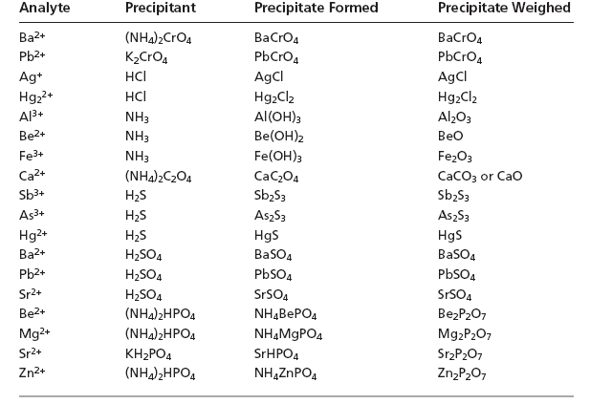

Slide 2
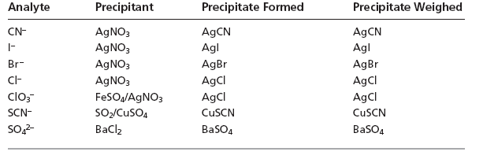

Slide 3
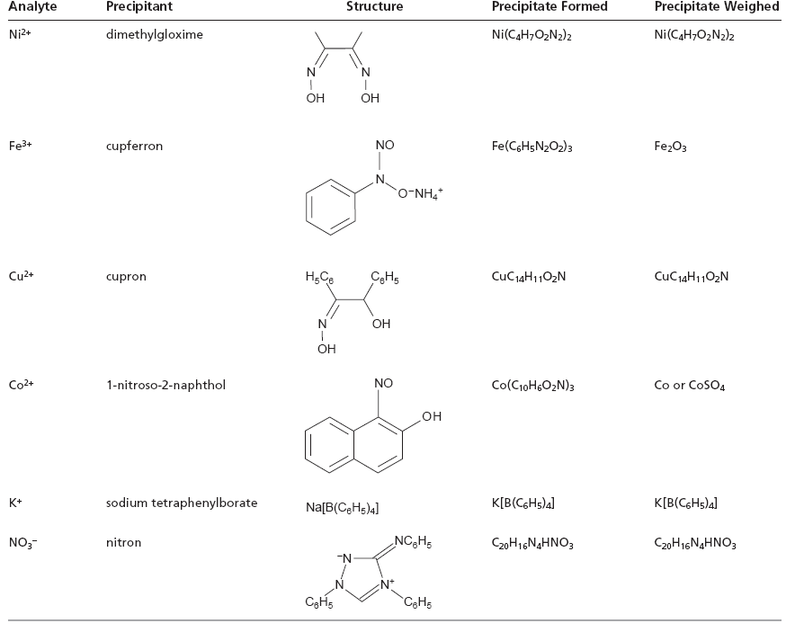

Slide 4
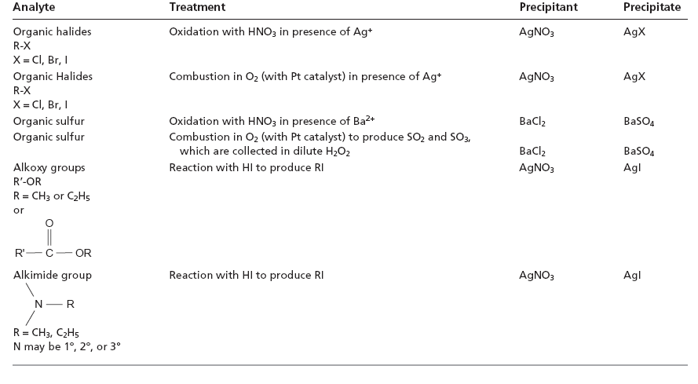

Slide 5

pH of solution
The solubility of Ca₃(PO₄)₂ is pH-dependent because phosphate is a weak base. The following four reactions, therefore, govern the solubility of Ca₃(PO₄)₂.
Ca₃(PO₄)₂(s) 3Ca²⁺(aq) + 2PO₄^{3–}(aq)
PO₄^{3–}(aq) + H₂O(l) HPO₄^{2–}(aq) + OH–(aq)
HPO₄ ^{2–}(aq) + H₂O(l) H₂PO₄–(aq) + OH–(aq)
H₂PO₄–(aq) + H₂O(l) H₃PO₄(aq) + OH–(aq)
Depending on the solution’s pH, the predominant phosphate species is either PO₄^{3–},HPO₄ ^{2–}, H₂PO₄–, or H₃PO₄

Slide 6
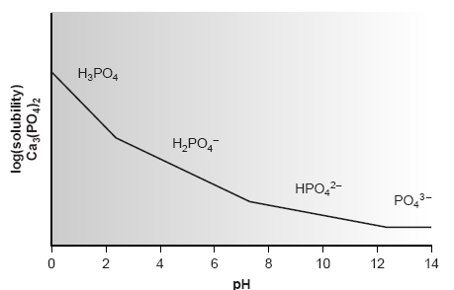
Solubility diagram for Ca₃(PO₄)₂ showing the predominant form of phosphate for each segment of the solubility curve.

Slide 7
Solvent Effect
Solubility can often be decreased by using a nonaqueous solvent.
A precipitate’s solubility is generally greater in aqueous solutions because of the ability of water molecules to stabilize ions through solvation.
The poorer solvating ability of nonaqueous solvents, even those that are polar, leads to a smaller solubility
product.
For example, PbSO₄ has a Ksp of 1.6 x10^{–8} in H₂O, whereas in a 50:50 mixture of H₂O/ethanol the K_{sp} at 2.6 x 10^{–12} is four orders of magnitude smaller

Slide 8

Solubility of precipitate
ΔH<0
T ↓ ⇒ solubility ↓
Vant Hoff equation
Polarity of solvent ↓ ⇒ solubility ↓
log Ks
ΔH>0
1/T
Hexane CCl₄ Benzene Toluene CHCl₃ Pyridine HAC Acetone EtOH MtOH CH₃CN Water
Non-polar
Polar

Slide 9
Filterability : large particle size
Precipitation mechanism
1) Induction period (few min) : A precipitant (counterion) is added
2) Nucleation : form small aggregates
3) Particle growth to form larger crystal
4) Adsorption
5) Electrostatic attraction to coalesce : electric double layer

Slide 10
Colloids
Colloids are particles with diameters in the range 1-100 nm.
They are larger than molecules, but too small to precipitate.
They remain in solution indefinitely, suspended by the Brownian motion (random movement) of solvent molecules.
Colloidal particles show no tendency to settle from solution and are not easily filtered.
The particles of crystalline suspension with the dimensions on the order of tenths of a millimeter or greater tend to settle spontaneously and are easily filtered.

Slide 11
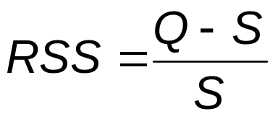
Filtration
The size of the precipitate’s particles determines the ease and success of filtration.
A solute’s relative supersaturation, RSS, can be expressed as
where Q is the solute’s actual concentration, S is the solute’s expected concentration at equilibrium, and
Q – S is a measure of the solute’s super-saturation when precipitation begins.

Slide 12
Filtration
A large, positive value of RSS indicates that a solution is highly supersaturated.
Such solutions are unstable and show high rates of nucleation, producing a precipitate consisting of numerous small particles.
When RSS is small, precipitation is more likely to occur by particle growth than by nucleation.
Larger particles form when the rate of particle growth exceeds the rate of nucleation.

Slide 13
Control of particle size
RSS can be minimized by either decreasing the solute’s concentration or increasing the precipitate’s solubility.
    Temperature
    pH
    Precipitation in a dilute solution of analyte
    Adding the precipitant slowly with vigorous stirring

Slide 14
Practical limitations
Precipitates that are extremely insoluble, such as Fe(OH)₃ and PbS, have such small solubilities that a large RSS cannot be avoided. Such solutes inevitably form small particles.
In addition, conditions that yield a small RSS may lead to a relatively stable supersaturated solution that requires a long time to fully precipitate.

Slide 15
Particle size
Another method for increasing particle size is by altering the charge on the surface of particles.
When a precipitate’s particles are electrically neutral, they tend to coagulate into larger particles.
Surface adsorption of excess lattice ions, however, provides the precipitate’s particles with a net positive or negative surface charge.
Electrostatic repulsion between the particles prevents them from coagulating into larger particles.

Slide 16
Consider, for instance, the precipitation of AgCl from a solution of AgNO₃, using NaCl as a precipitant.
Early in the precipitation, when NaCl is the limiting reagent, excess Ag⁺ ions chemically adsorb to the AgCl particles, forming a positively charged primary adsorption layer.
Anions in solution, in this case NO ^{3 –} and OH–, are attracted toward the surface, forming a negatively charged secondary adsorption layer that balances the surface’s positive charge.
The solution outside the secondary adsorption layer remains electrically neutral.
Coagulation cannot occur if the secondary adsorption layer is too thick because the individual particles of AgCl are unable to approach one another closely enough.

Slide 17
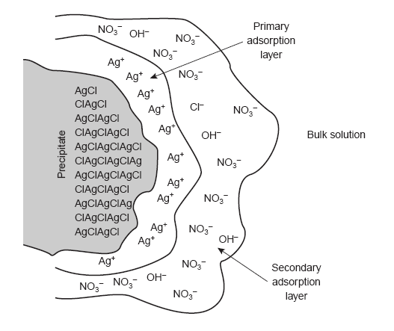
Electrical Double layer

Slide 18
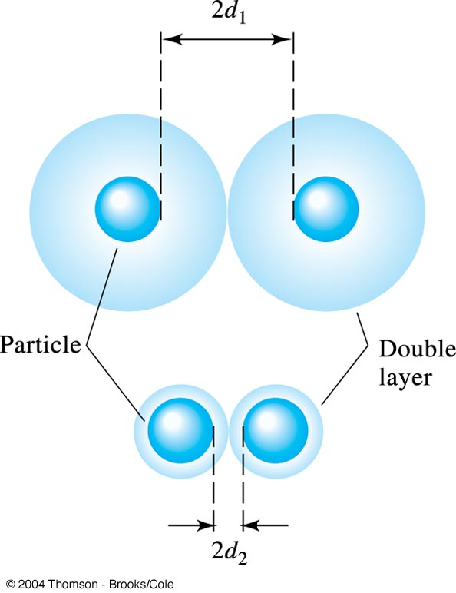
The electrical double layer of a colloid consists of a layer of charge adsorbed on the surface of the particle (the primary adsorption layer) and a layer of opposite charge (the counter-ion layer) in the solution surrounding the particle.
Increasing the electrolyte concentration has the effect of decreasing the volume of the counter-ion layer, thereby increasing the chance for coagulation.

Slide 19
Coagulation
Coagulation can be induced in two ways:
by increasing the concentration of the ions responsible for the secondary adsorption layer or by heating the solution.
The addition of an inert electrolyte that increases the concentration of ions in the secondary adsorption layer.
With more ions available, the thickness of the secondary adsorption layer decreases.
Particles of precipitate may now approach one another more closely, allowing the precipitate to coagulate.
The amount of electrolyte needed to cause spontaneous coagulation is called the critical coagulation concentration.

Slide 20
Coagulation
Heating the solution and precipitate provides a second way to induce coagulation.
As the temperature increases, the number of ions in the primary adsorption layer decreases, lowering the precipitate’s surface charge.
In addition, increasing the particle’s kinetic energy may be sufficient to overcome the electrostatic repulsion preventing coagulation at lower temperatures

